Slide 1
CSE315:Introduction to Data Science
WEEK-4

Slide 2
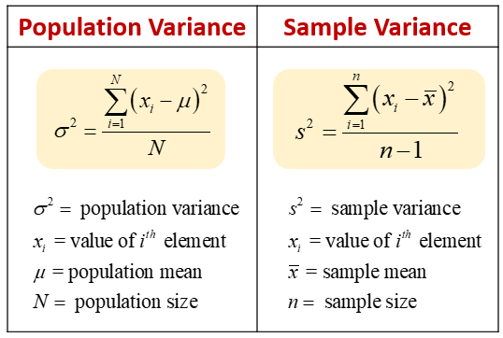
Data Spread
Variation - Variation is a measure of how far the data in a data set is from its average value. The range determines the extent of the data, but this is only the sum of the maximum and minimum values. So the whole data image by range is not available. How far or near the average value of the data is located is measured by variance.
Mathematical equations for determining variance in terms of population and sample data

Slide 3
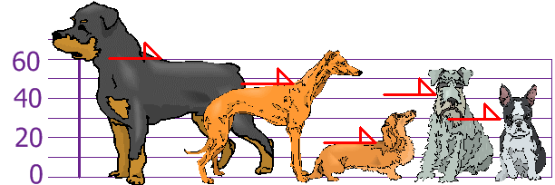

Variance
Suppose the height of 5 dogs of different breeds is 60 cm, 47 cm, 17 cm, 43 cm and 30 cm respectively, so the average height of dogs is 39.4 cm.
Determining the population variance of the height of different breeds of dogs…
So we understand that the height of dogs can vary by 217.04 cm from their average value.

Slide 4

Standard Deviation
The value of the variance may vary from case to case, with the variance being much lower if the height of the dogs were measured on a "foot" scale. So many times it becomes difficult to decide from variance, that's why we use another method called standard deviation.
Standard Deviation - The standard deviation is obtained by rooting the value of the variance.

Slide 5
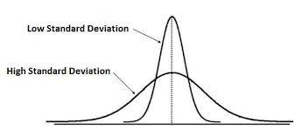
What do I understand by standard deviation?
We saw earlier that the average height of 5 different breeds of dogs was 39.4 cm and their standard deviation was 14.73 cm. This means that the height of the dogs will be within 39.4 cm + - 14.73 cm or (24.67 mm or 54.13 cm).
If the standard deviation of a data is less then most of the values ​​are near the center i.e. the variation is less. Again, standard deviation means more variation in data.

Slide 6
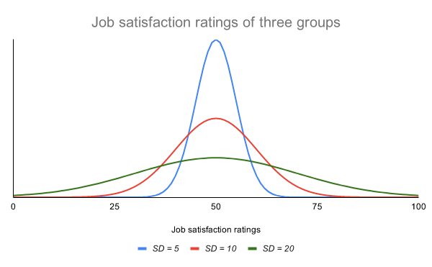
Meaning from curve
Suppose the curve of the lower standard deviation above is the distribution of the run of the batsman "A" and the curve of the higher standard deviation is the distribution of the run of the batsman "B".
From this it is clear that the "A" batsman is more reliable, he has run close in most of the matches. On the other hand, "B" is a lot of unpredictable variations of his runs, in some matches he has scored a lot of runs and in some matches he has scored very few runs.

Slide 7
Covariance and Correlation
Suppose you want to know if ice cream selling has any relation with daily temperature?
To do this, you took a few days 'worth of ice cream sales data from a store next to your home and took data on those days' temperature.
Selling ice cream and scattering the temperature clearly shows that as the temperature rises, so does the sale of ice cream. If the temperature goes down again, the sales of ice cream also go down.

Slide 8
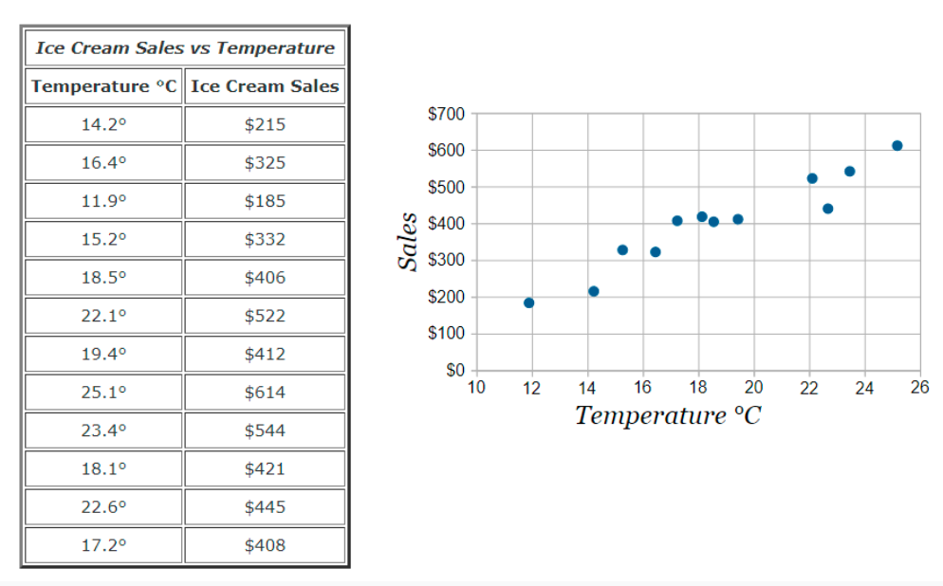
Ice Cream Sales Data

Slide 9
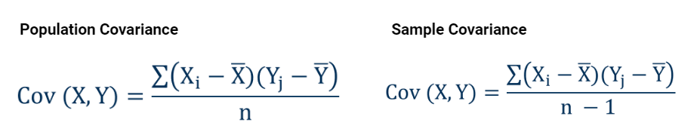
Covariance
Covariance - Covariance is the measure of the simultaneous change of two variables. Covariance shows how much two variables change together, how much relation exists between one variable and another variable.
To determine the population covariance, two variables have to divide the product of their average value subtraction by the total number of observations n. Sample covariance, on the other hand, has to be divided by n-1 in the same way.

Slide 10
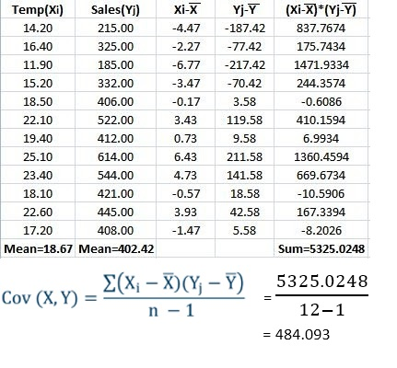
Covariance
We will apply the formula of sample covariance to determine the covariance of temperature and quantity of ice cream sales in our ice cream sales sample data.
By subtracting the above, we know that the ice cream sales volume and temperature coverage is 484.09.
There is no scale of covariance value, the value of variable changes with the value of covariance.
So many times it becomes difficult to come to a conclusion from covariance.
So we'll get to know another measurement, that is correlation.

Slide 11
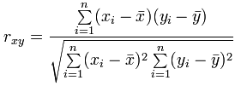
Correlation
Correlation- Correlation is a measure of the relationship between two variables. That is, if the value of one variable increases or decreases, the measure of how much the value of the other variable increases or decreases is expressed through correlation.
The value of correlation is scaled, ranging from -1 to 1. The closer to 1 the stronger the relationship between the two variables, the weaker the relationship closer to 0.
The above equation is Pearson correlation equation, expressed by r.

Slide 12
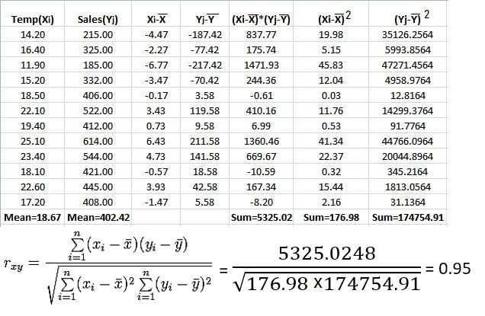
Pearson correlation

Slide 13
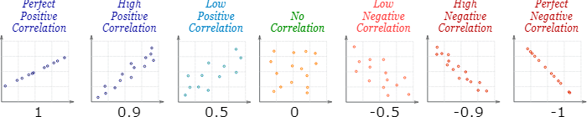
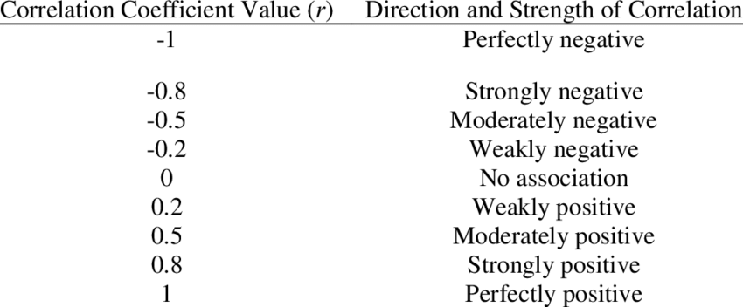
Pearson correlation
According to Pearson's method, we see that the relationship between ice cream sales and temperature is 0.95, which is a very strong correlation.

Slide 14
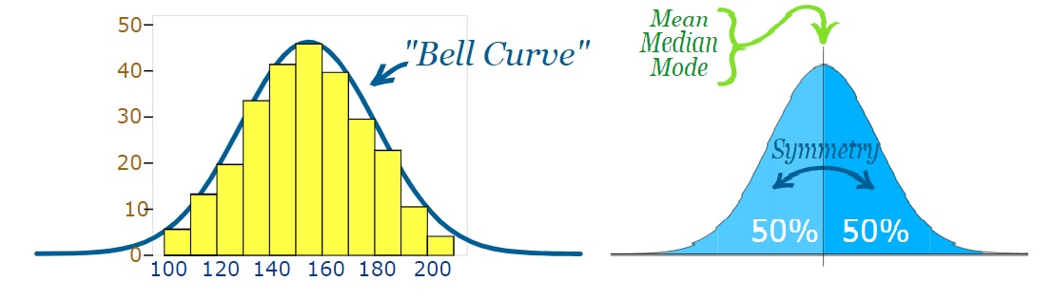
Normal Distribution
The appearance of real life data can be varied. However, sometimes the appearance of the data is a lot like the shape of a bell or a bell shape.
If the data looks like a bell shape of a data distribution plot, then it is called normal distribution.
In the perfect normal distribution, the data mean, mode and median are exactly in the middle and the values ​​of all are equal. Distribution consists of 50% data on both sides, i.e. data distribution is symmetric.

Slide 15
Examples of Normal Distribution
Some examples of normal distribution in real life,
The weight of the newborn baby
Income distribution
The height of man
IQ
Blood pressure
Exam results
The amount of error of any measurement

Slide 16
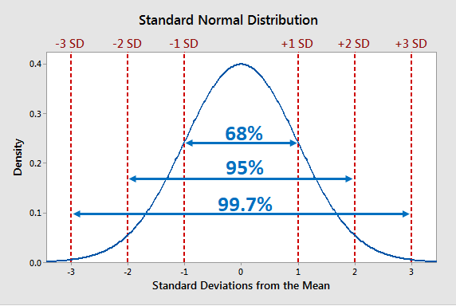
Empirical law of distributions
There is a nice thing about normal distribution, it's called empirical Law of Distribution.
68% of the data in a normal distribution is within the standard deviation 1.
95% of data is within standard deviation 2 and
99.7% of data is within standard deviation 3.

Slide 17
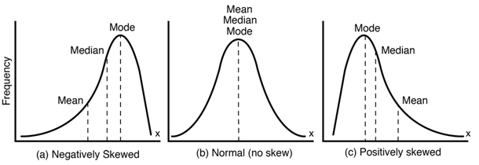
Skewness
Normal distribution data is symmetrical, meaning that there is an equal amount of data on both sides. When a curve moves slightly to the right or left it is no longer symmetric, such a curve is called asymmetric.
Skewness is a measure of the degree of asymmetry of a distribution curve. If the curve is tilted to the right compared to the normal curve then it is called negative skewed curve, whereas if the curve is tilted to the left from the normal curve then it is called positive skewed curve.
Skewness | Type
Skewness<0 | Negatively Skewed
Skewness=0 | No Skewed
Skewness>0 | Positively Skewed

Slide 18
Skewness Example
Negative Skewness (Long Tail to the Left):
Test Scores: In a well-designed test, most students score around the average, with fewer scoring very high or very low. This creates a negative skew, with a tail extending towards lower scores.
Number of Customers Entering a Store: On a typical day, a store might see a larger number of customers during peak hours and fewer throughout the rest of the day. This can result in a negatively skewed distribution of customer arrivals.

Slide 19
Skewness Example
No Skew (Symmetrical Distribution):
Dice Rolls: When you roll a fair die, each number (1 to 6) has an equal probability of landing. This results in a perfectly symmetrical distribution with no skew.
Heights of Adults: While individual heights can vary, the overall distribution of adult heights in a population often approximates a normal curve with no significant skew.

Slide 20
Skewness Example
Positive Skewness (Long Tail to the Right):
Household Income: This is a classic example of positive skewness. Most people earn a modest income, while a few individuals have significantly higher incomes (millionaires and billionaires). This creates a long tail on the right side of the distribution.
Waiting Times at a Coffee Shop: The time it takes to get your coffee at a busy shop can also be positively skewed. While most customers wait a few minutes, some might encounter longer wait times due to complex orders, unexpected delays, etc.

Slide 21
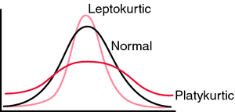
Kurtosis
Even if a distribution is symmetrical, it can be pointed or slightly dull.
Kurtosis is a measure of how pointed or blunt the shape of a distribution curve is.
If a symmetric distribution curve is pointed, it is called Leptokurtic, and if the curve is blunt in shape, it is called Platykurtic. The curve of normal shape is called mesokurtic.
Kurtosis | Type
Kurtosis<0 | Platykurtic
Kurtosis=0 | Mesokurtic
Kurtosis>0 | Leptokurtic

Slide 22
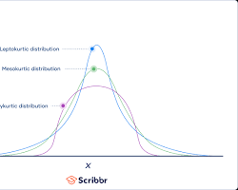
Kurtosis Example
Normal Distribution (Mesokurtic): Imagine a perfect bell curve, like the one representing heights of adults. This is a mesokurtic distribution, with a kurtosis value of 3.
The tails gradually taper off without any extreme outliers, and most of the data points cluster around the central peak.

Slide 23
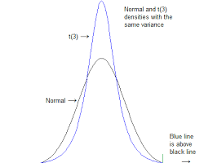
Kurtosis Example
Leptokurtic Distribution (Heavy Tails): Think of exam scores in a really tough class. This could be a leptokurtic distribution, with kurtosis exceeding 3.
The tails are much thicker and extend further out compared to a normal distribution. This means there are more extreme values (both very high and very low scores) than we'd expect in a normal curve.

Slide 24
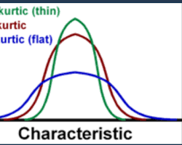
Kurtosis Example
Platykurtic Distribution (Light Tails): Picture the waiting times at a bank with multiple tellers. This might be a platykurtic distribution, with kurtosis less than 3.
The tails are flatter and thinner than in a normal distribution. This indicates fewer outliers and a more concentrated central mass, meaning most customers wait for a moderate amount of time.

